Slide 1
Football Data Analytics
By Rachit Singh 22CD3024

Slide 2
Contents In the project
EPL (English Premier League) Data Analytics
Determining Underrated Players
Creating Advanced Visualizations
Ronaldo v/s Messi Rivalry Comparison
UCL (UEFA Champions League) Data Analytics

Slide 3
Data Collection
We basically went onto different websites in order to find usable data for the project .
At the end we found out about fbref and their dataset for the Premier League Season 2022-23. Also we used other datasets from Kaggle, etc.
We gathered data from them for further analysis as they had data for various parameters on which we can compare the teams and the players.

Slide 4
Feature Selection
For the initial part we want to compare the players present in the league .
After doing some research around the web(We used sources like The Athletic, SofaScore) we found out that we can compare the players on the following basis :
Chance Creation
Progressive Carries
Pass Completion

Slide 5
Data Integration
Data for the different attributes is present in different tables so no we combine the data from tables using the name of the player as a primary key.
To avoid data duplication we check the other parameters like age and their team if such case exists.

Slide 6
Data Cleaning
Now the records that we obtained are for the entire season and different players have played for different amount of games due to various reasons.
Therefore , in order to find the better players we determine the output they produce per 90 minutes of play .
The problem which arises here is that there are some players who have played lot less like 2-3 matches out of the possible 38 so to get better analysis we have to remove them as they may act like an anomaly.
This was taken after seeing various reports from sites like athletic..

Slide 7
EPL Data Analytics
English Football Apex: The Premier League reigns as the pinnacle of English football.
Top-Flight Teams: Comprising 20 elite clubs, it features England's football powerhouses.
Global Attraction: With a massive international fanbase, the league captivates audiences worldwide.
Competitive Intensity: Known for its unpredictability, each season brings fierce battles for the coveted title.
Footballing Drama: A thrilling mix of skill, passion, and drama, the Premier League is a football spectacle unmatched in excitement.

Slide 8
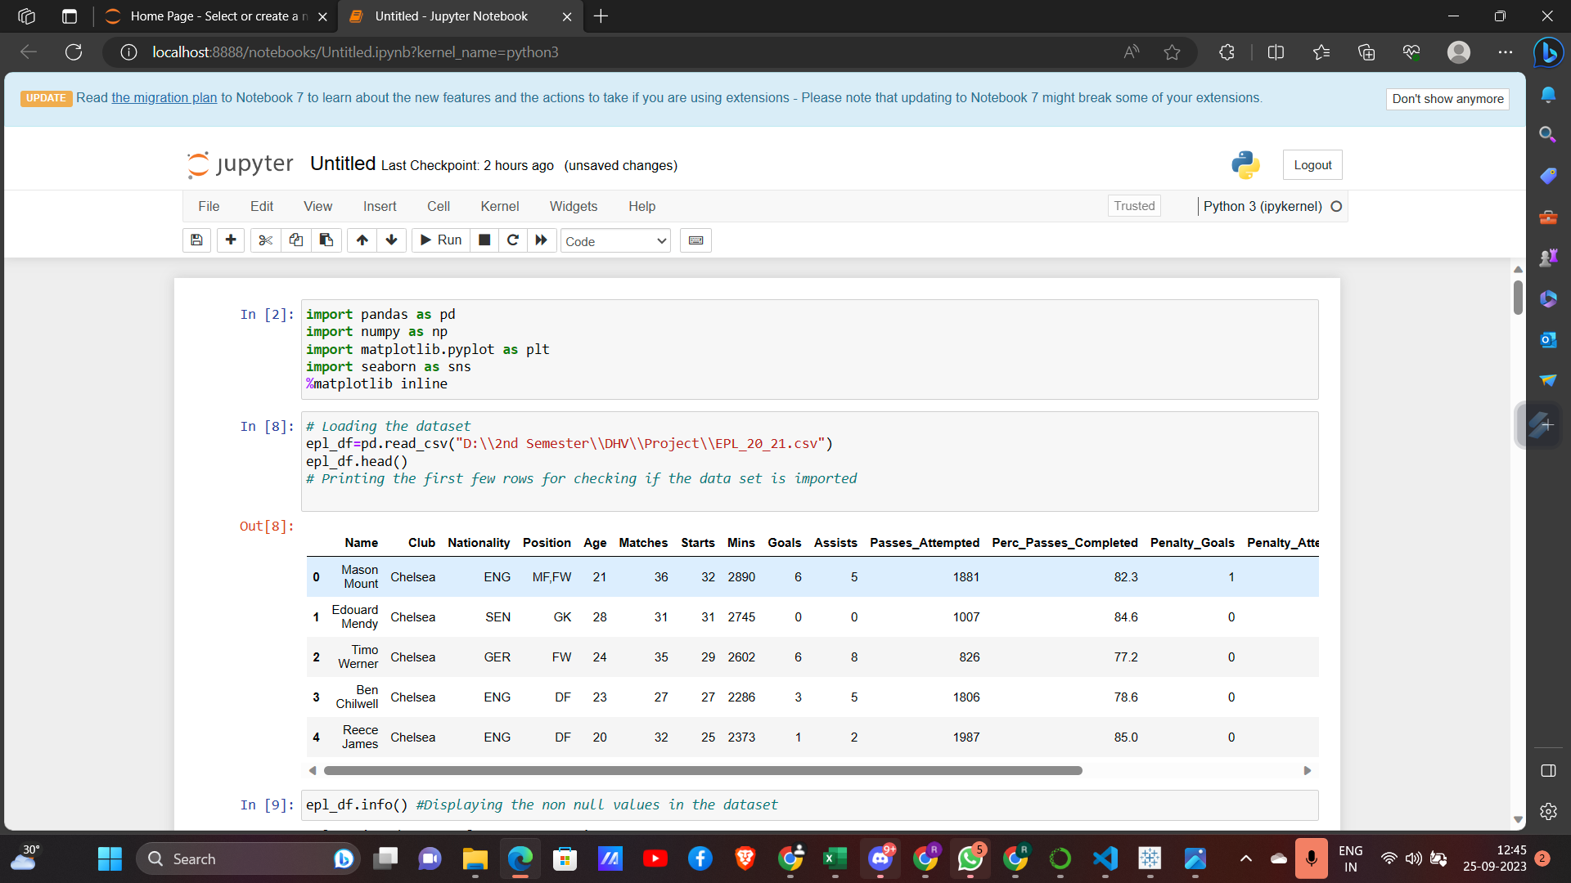
Loading the Dataset

Slide 9
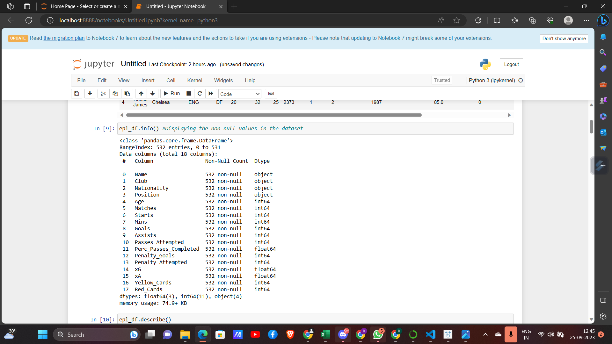
Displaying The Basic Info About Dataset

Slide 10
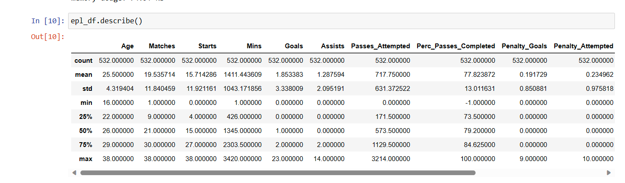
Describing all the Parameters of Dataset

Slide 11
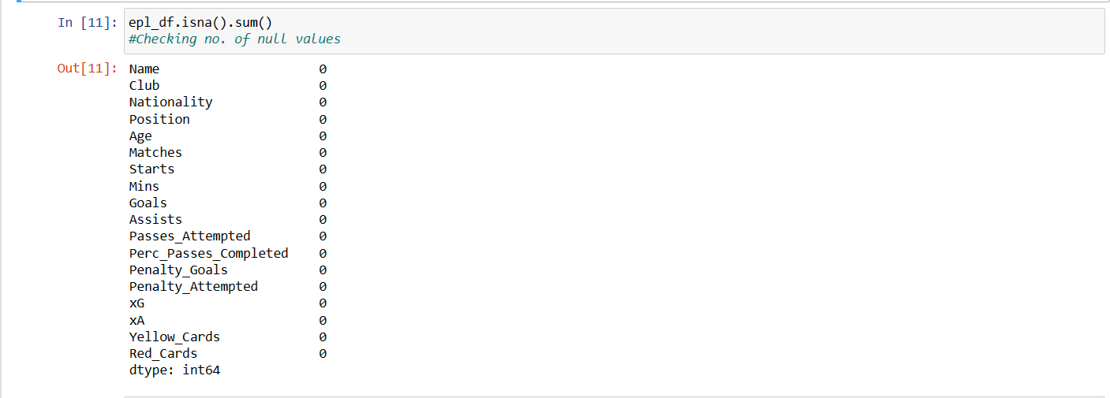
Checking No. of Null Values

Slide 12
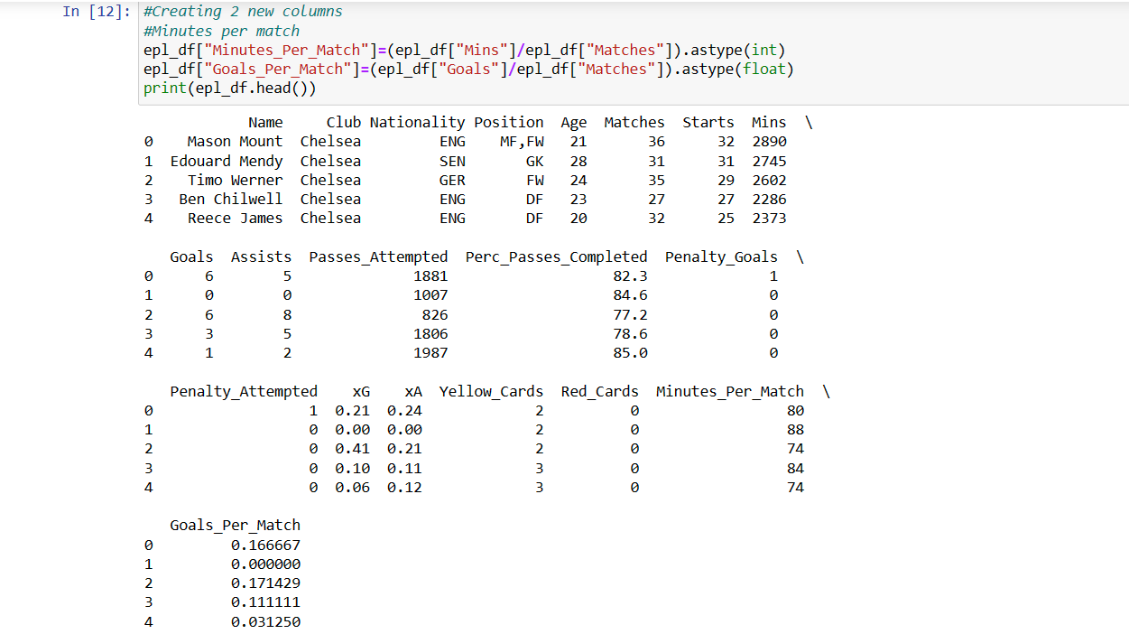
Inserting Columns for Minutes Played and Goals

Slide 13
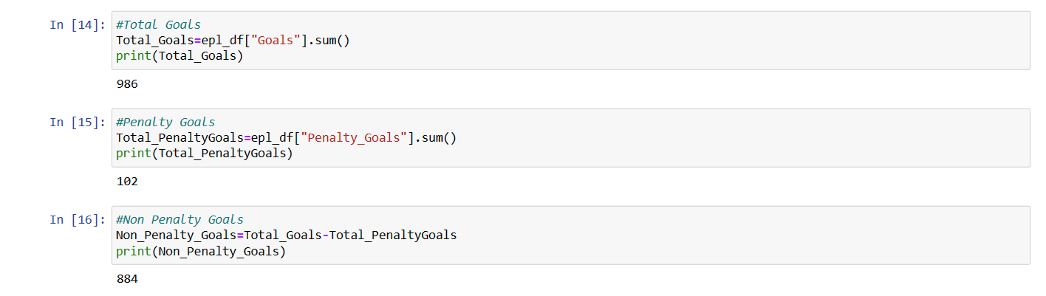
Total Goals Scored : Penalty and Non Penalty Goals

Slide 14
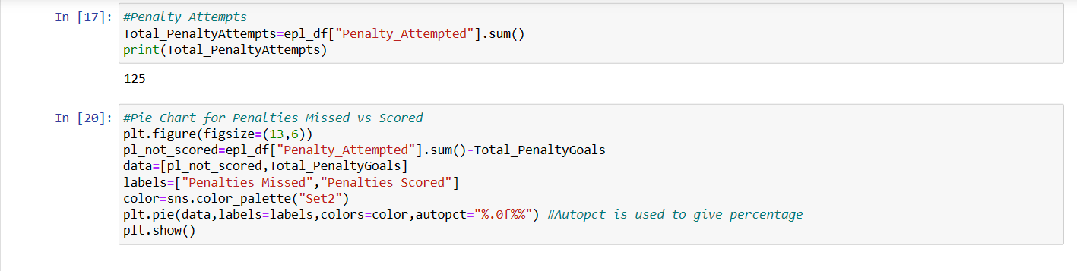
Penalty Attempts and Code for Penalties Missed vs Scored Pie Chart

Slide 15
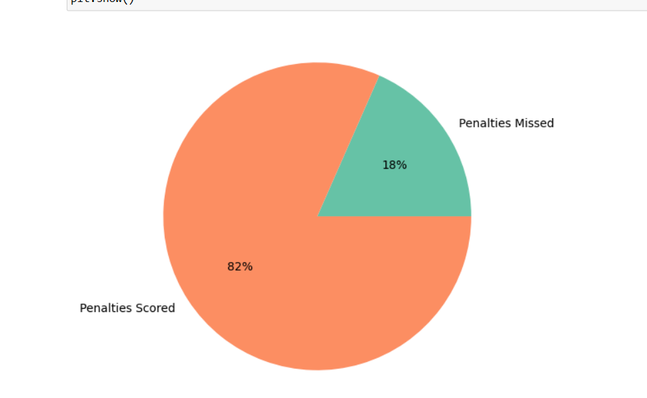
Output Pie Chart

Slide 16
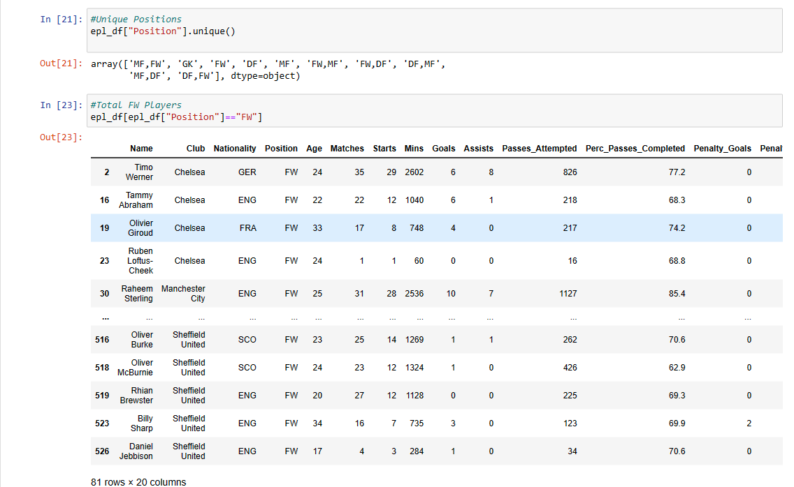
Unique and Positions and Players Playing Each Position

Slide 17
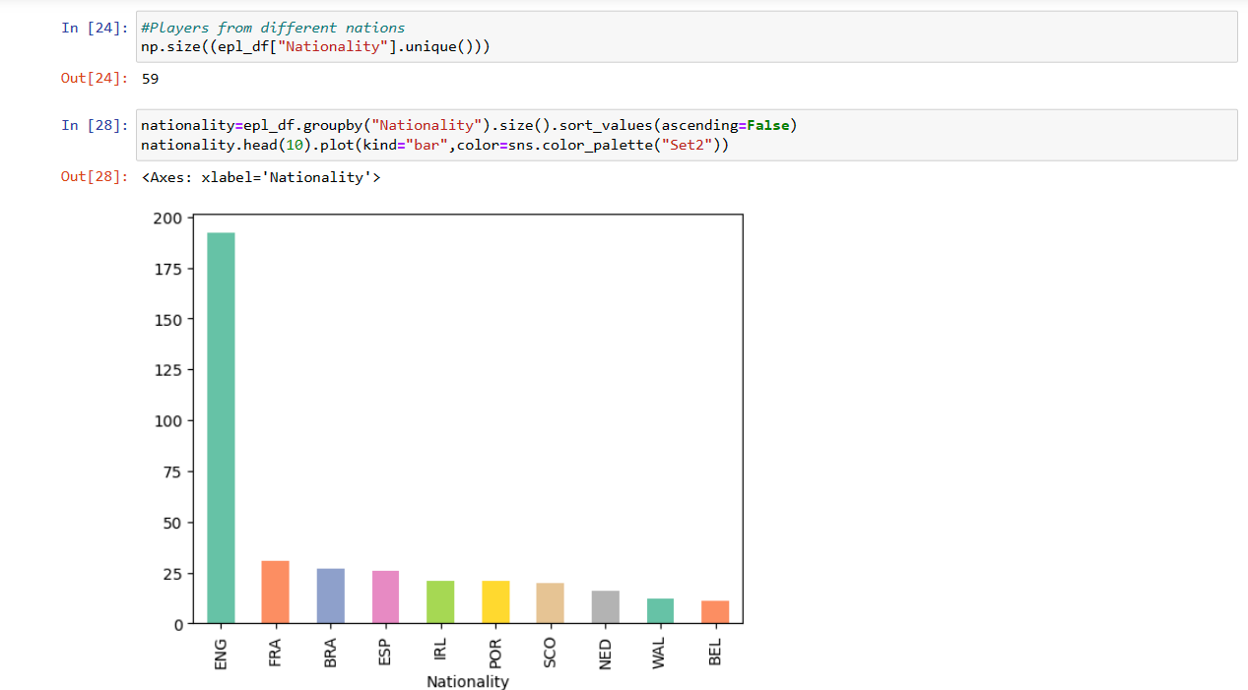
Different Nationalities

Slide 18
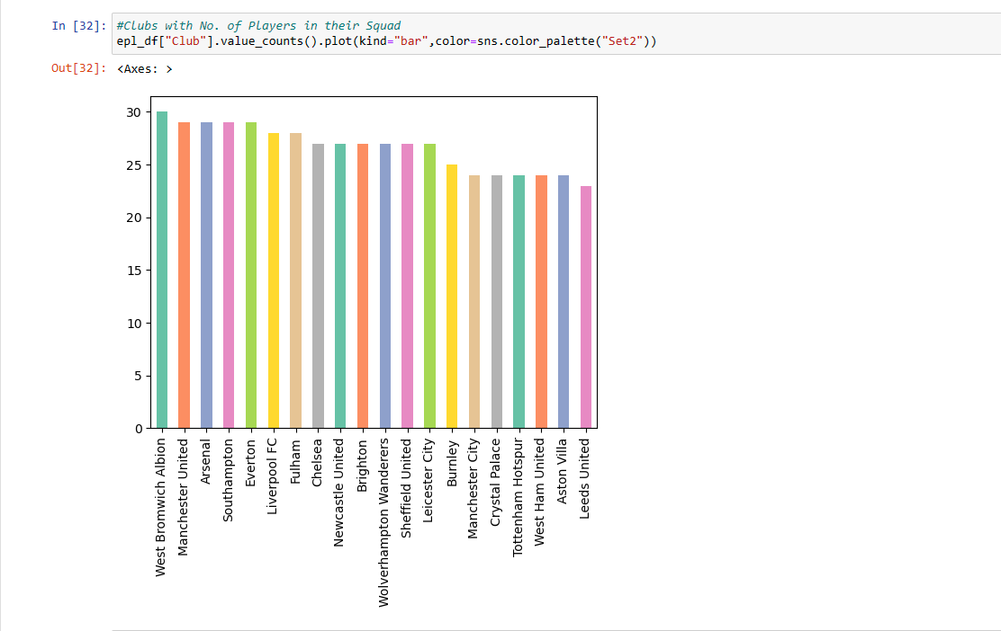
No. of Players at Each Club

Slide 19
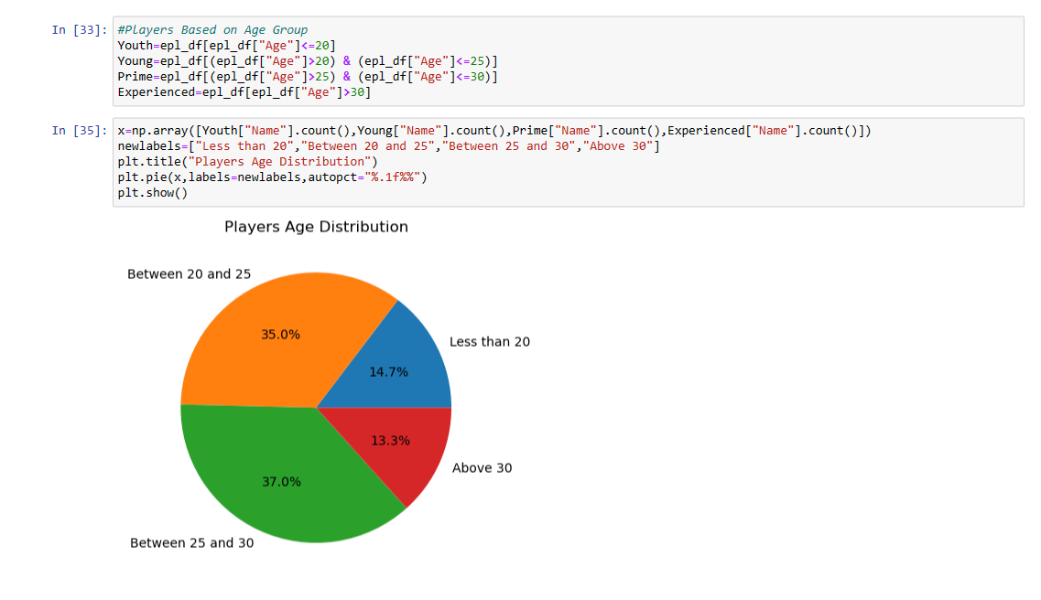
Age Distribution of Players

Slide 20
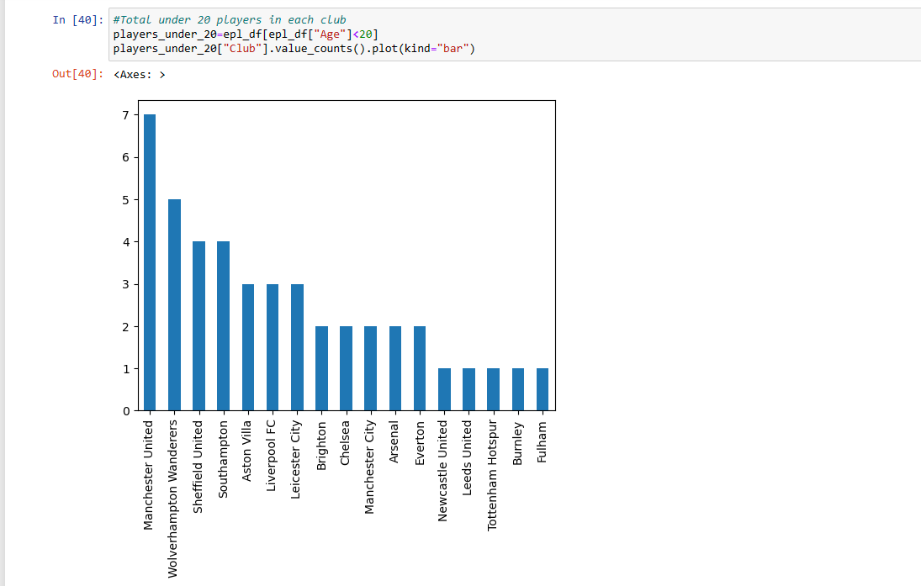
No. of Players Aged Under 20 at Each Club

Slide 21
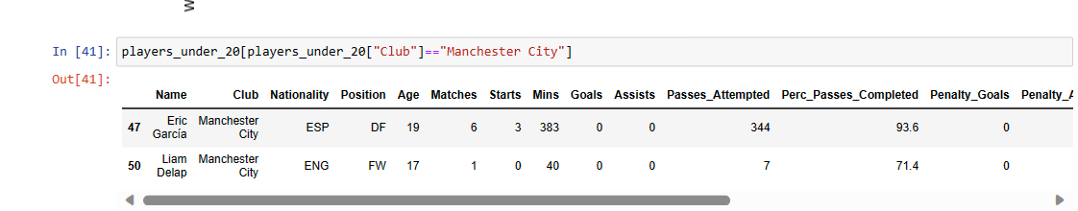
Displaying the Players Aged Under 20

Slide 22
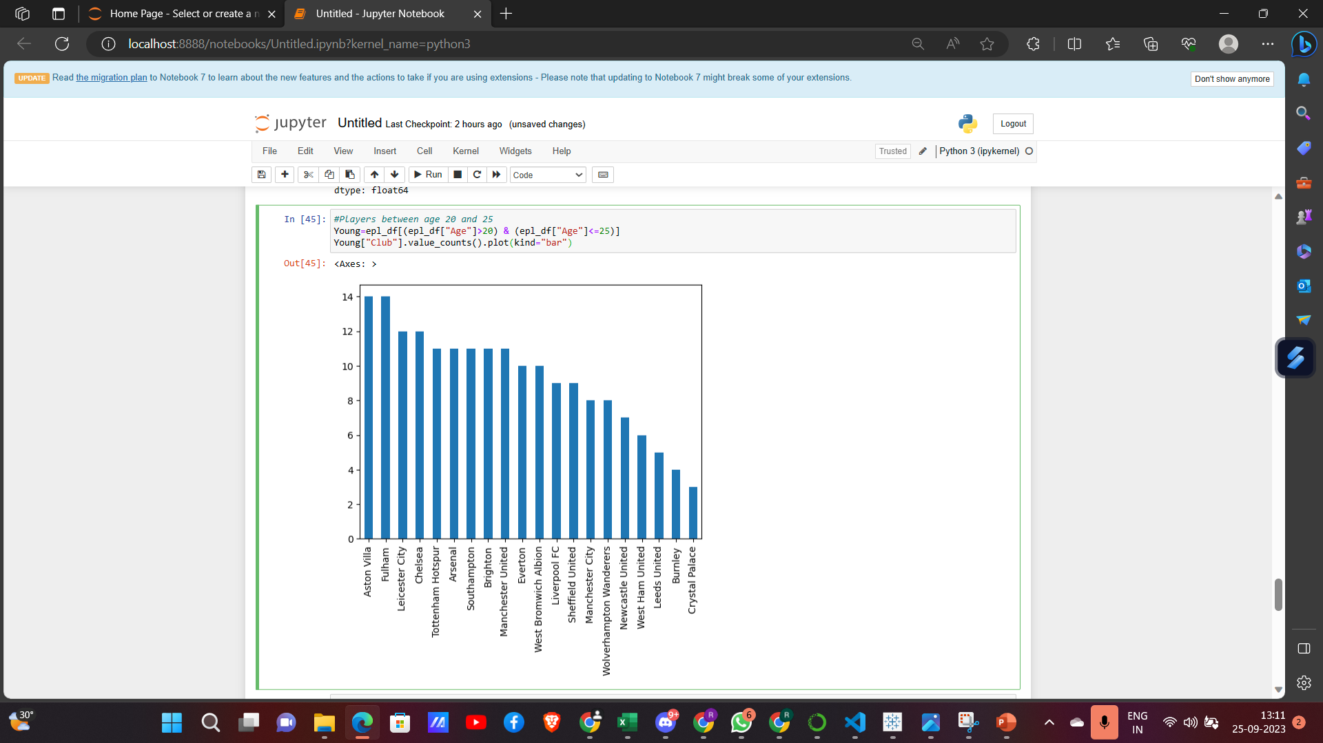

Slide 23
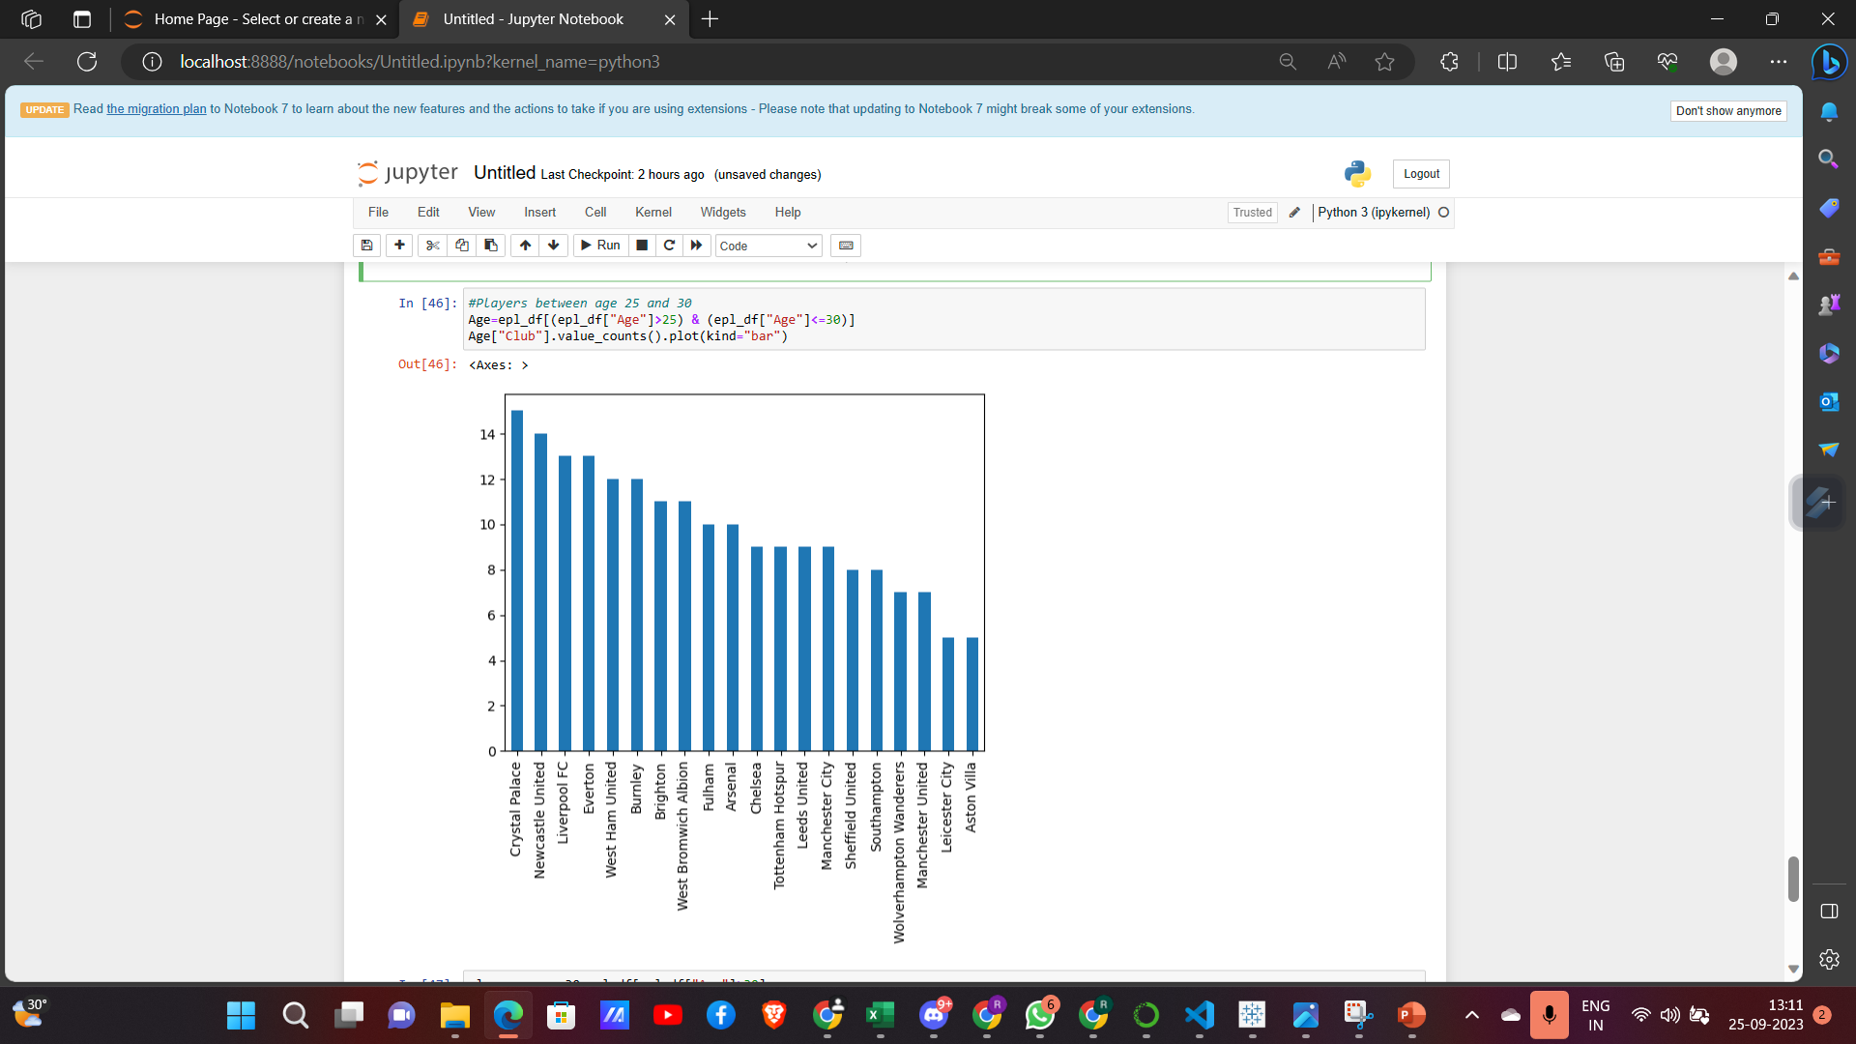

Slide 24
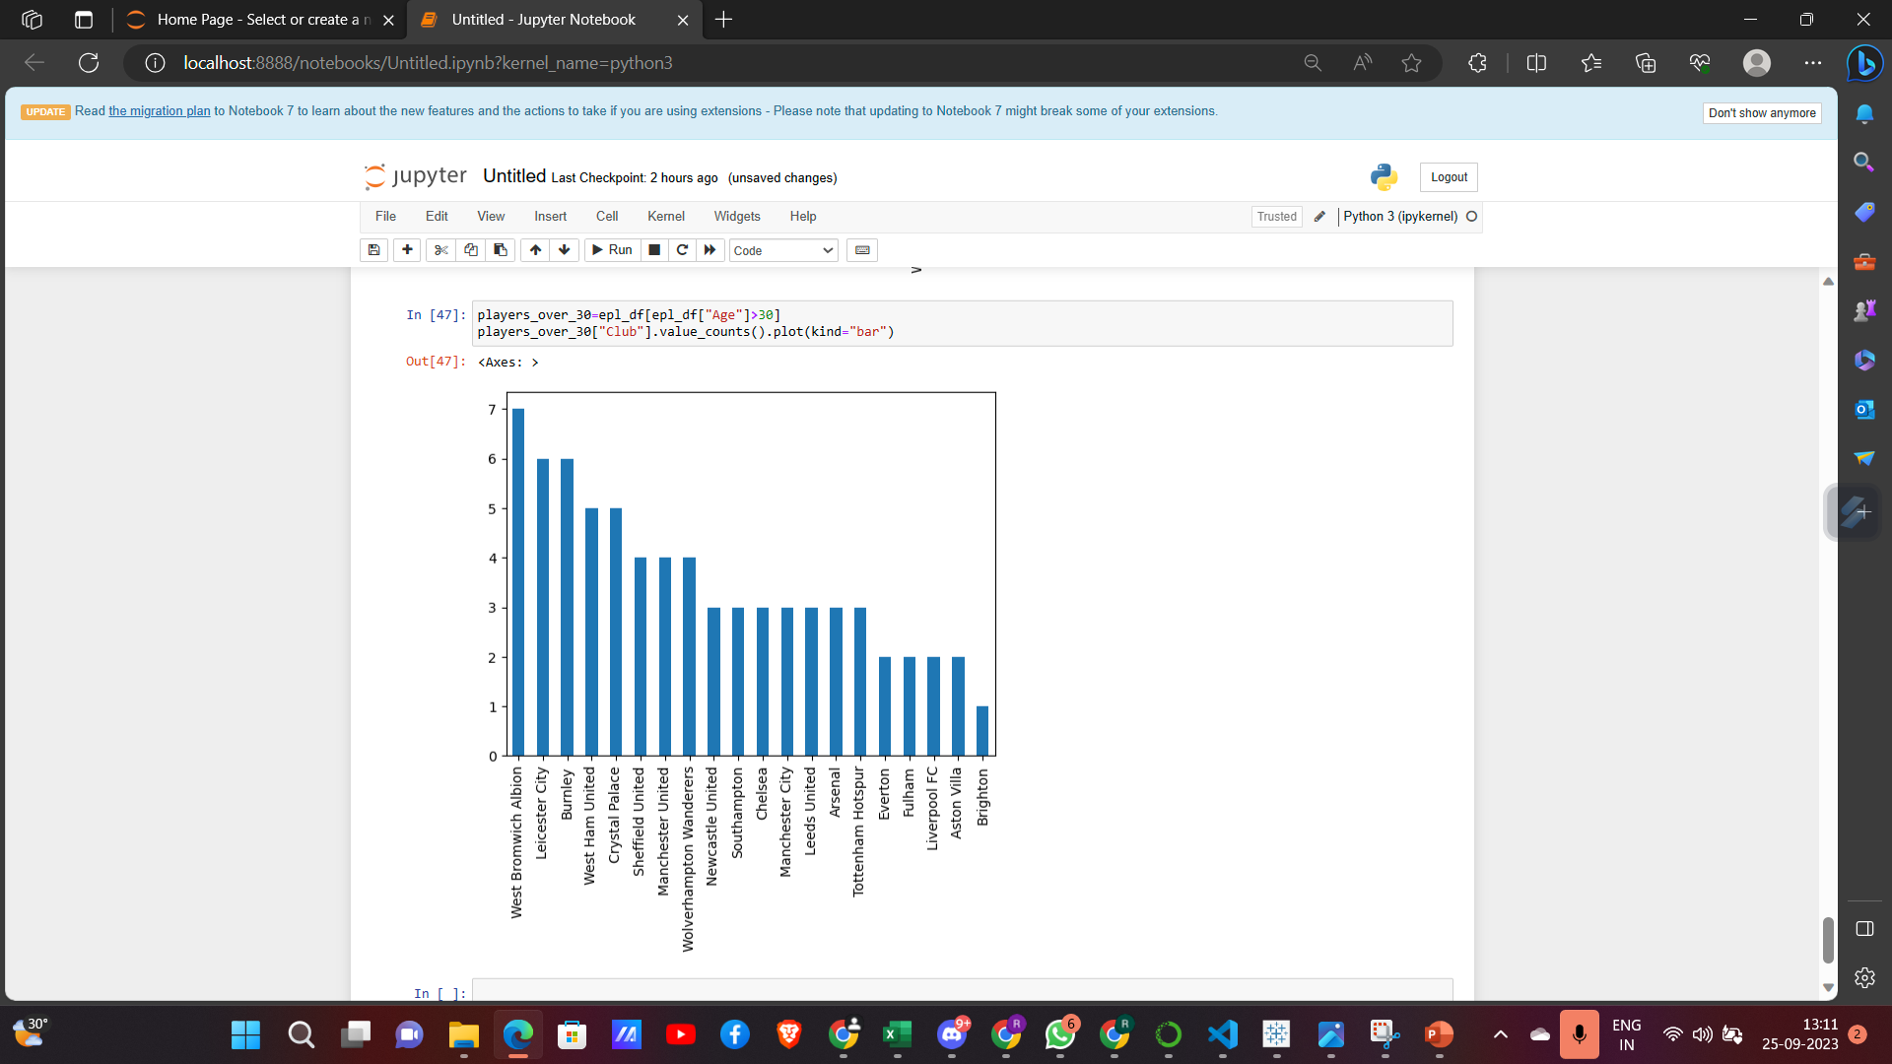

Slide 25
Box Plot for Average Age of Players

Slide 26
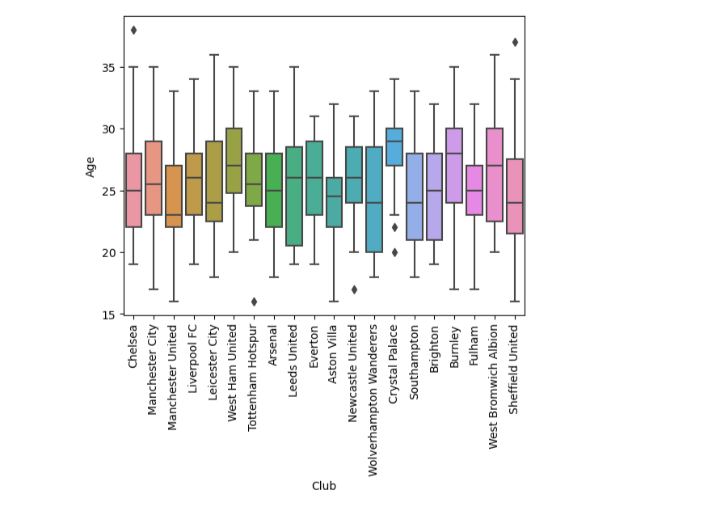
Box Plot Distribution for Age Distribution

Slide 27
Determining Underrated Players
We analyse players on the basis of their stats. Here, we gather their stats on basis of the position they play and compare with existing players to find the profile needed for the team
This lets teams buy players at a lesser price which saves a lot of money .
This approach was also shown in the movie Money Ball and is used by many clubs in the transfer market like Brentford, Benfica, Ajax, Brighton who have a comparatively lesser budget.

Slide 28
Comparison of players ..
We would be comparing players based on their previous season stats .
This would help the other teams get the perfect player for their desired position at a cheaper price.
For the same purpose, we have used Tableau.

Slide 29
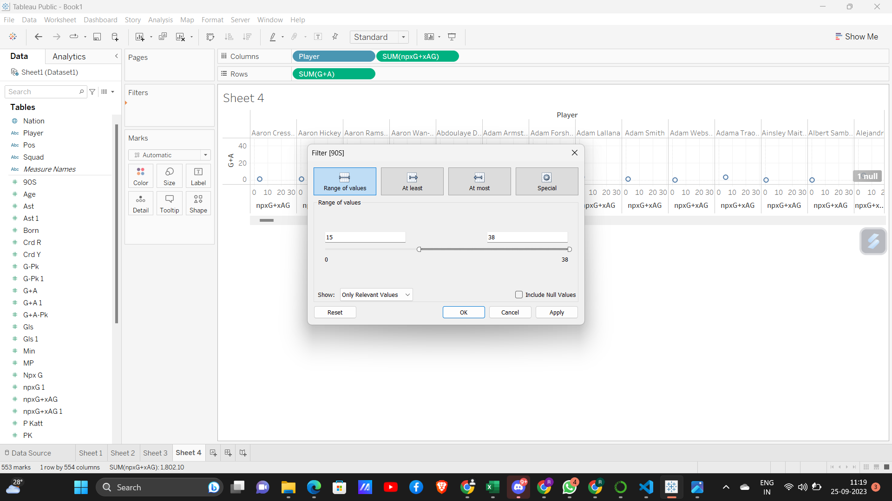

Slide 30
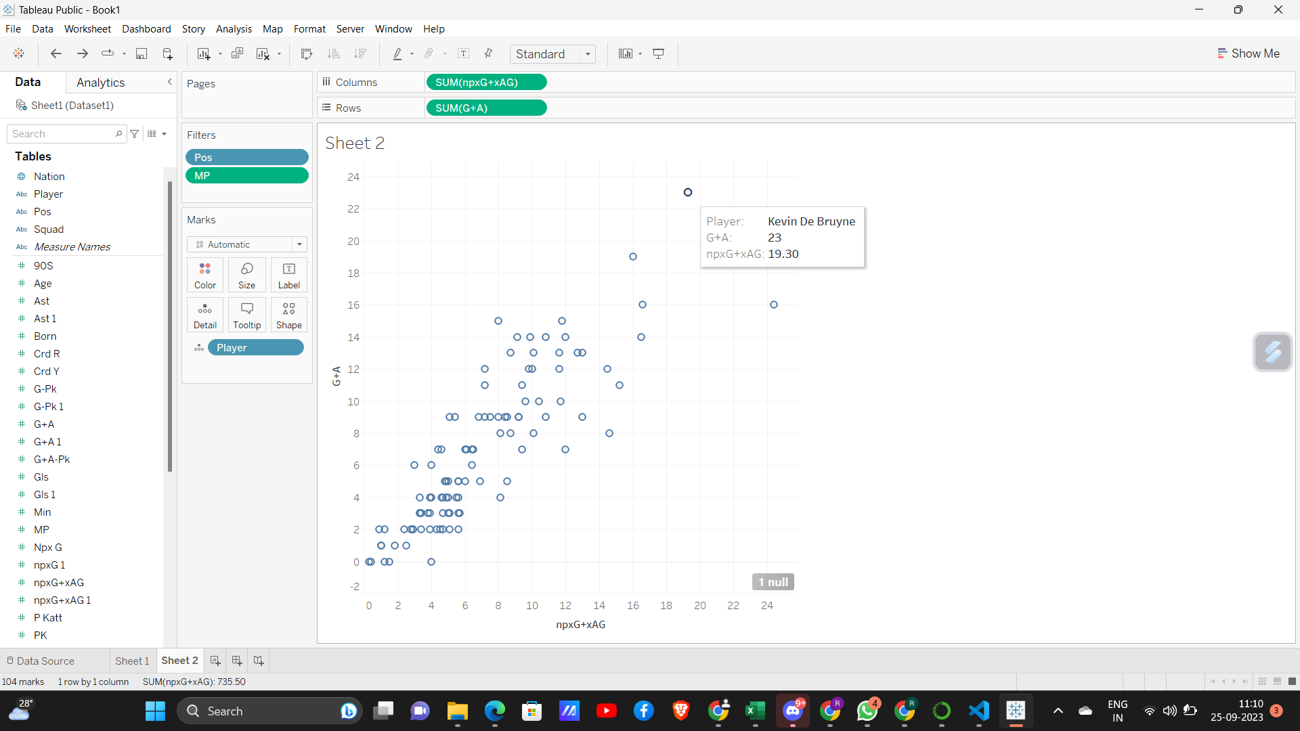
Comparing Various Midfielders

Slide 31
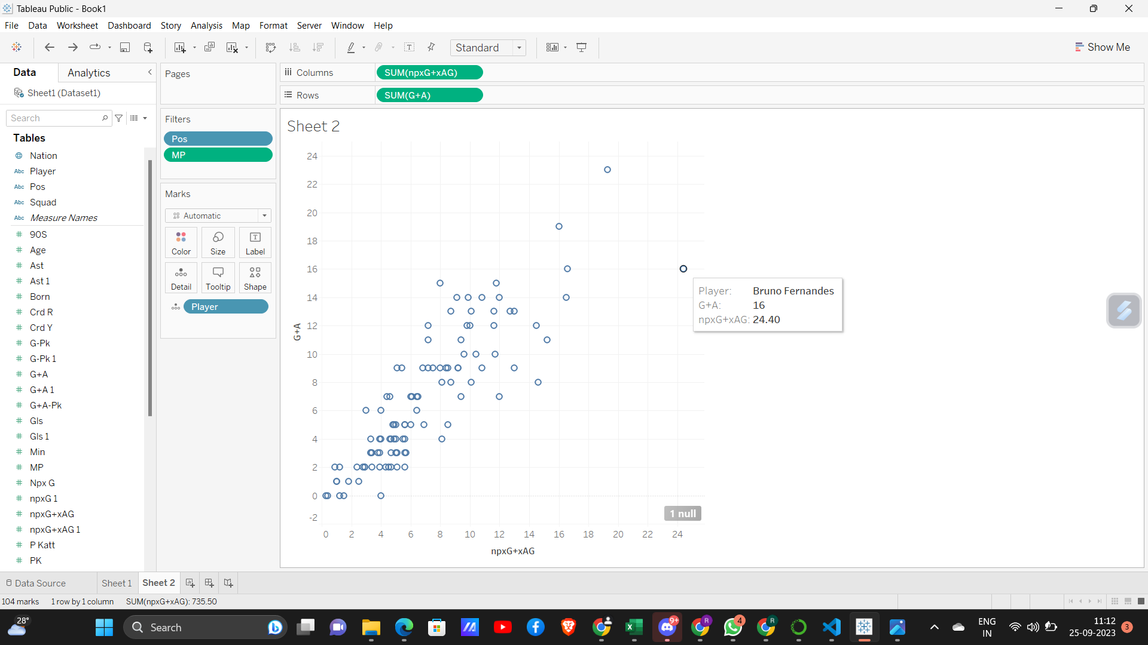
This shows that Kevin and Bruno are one of the very best…

Slide 32
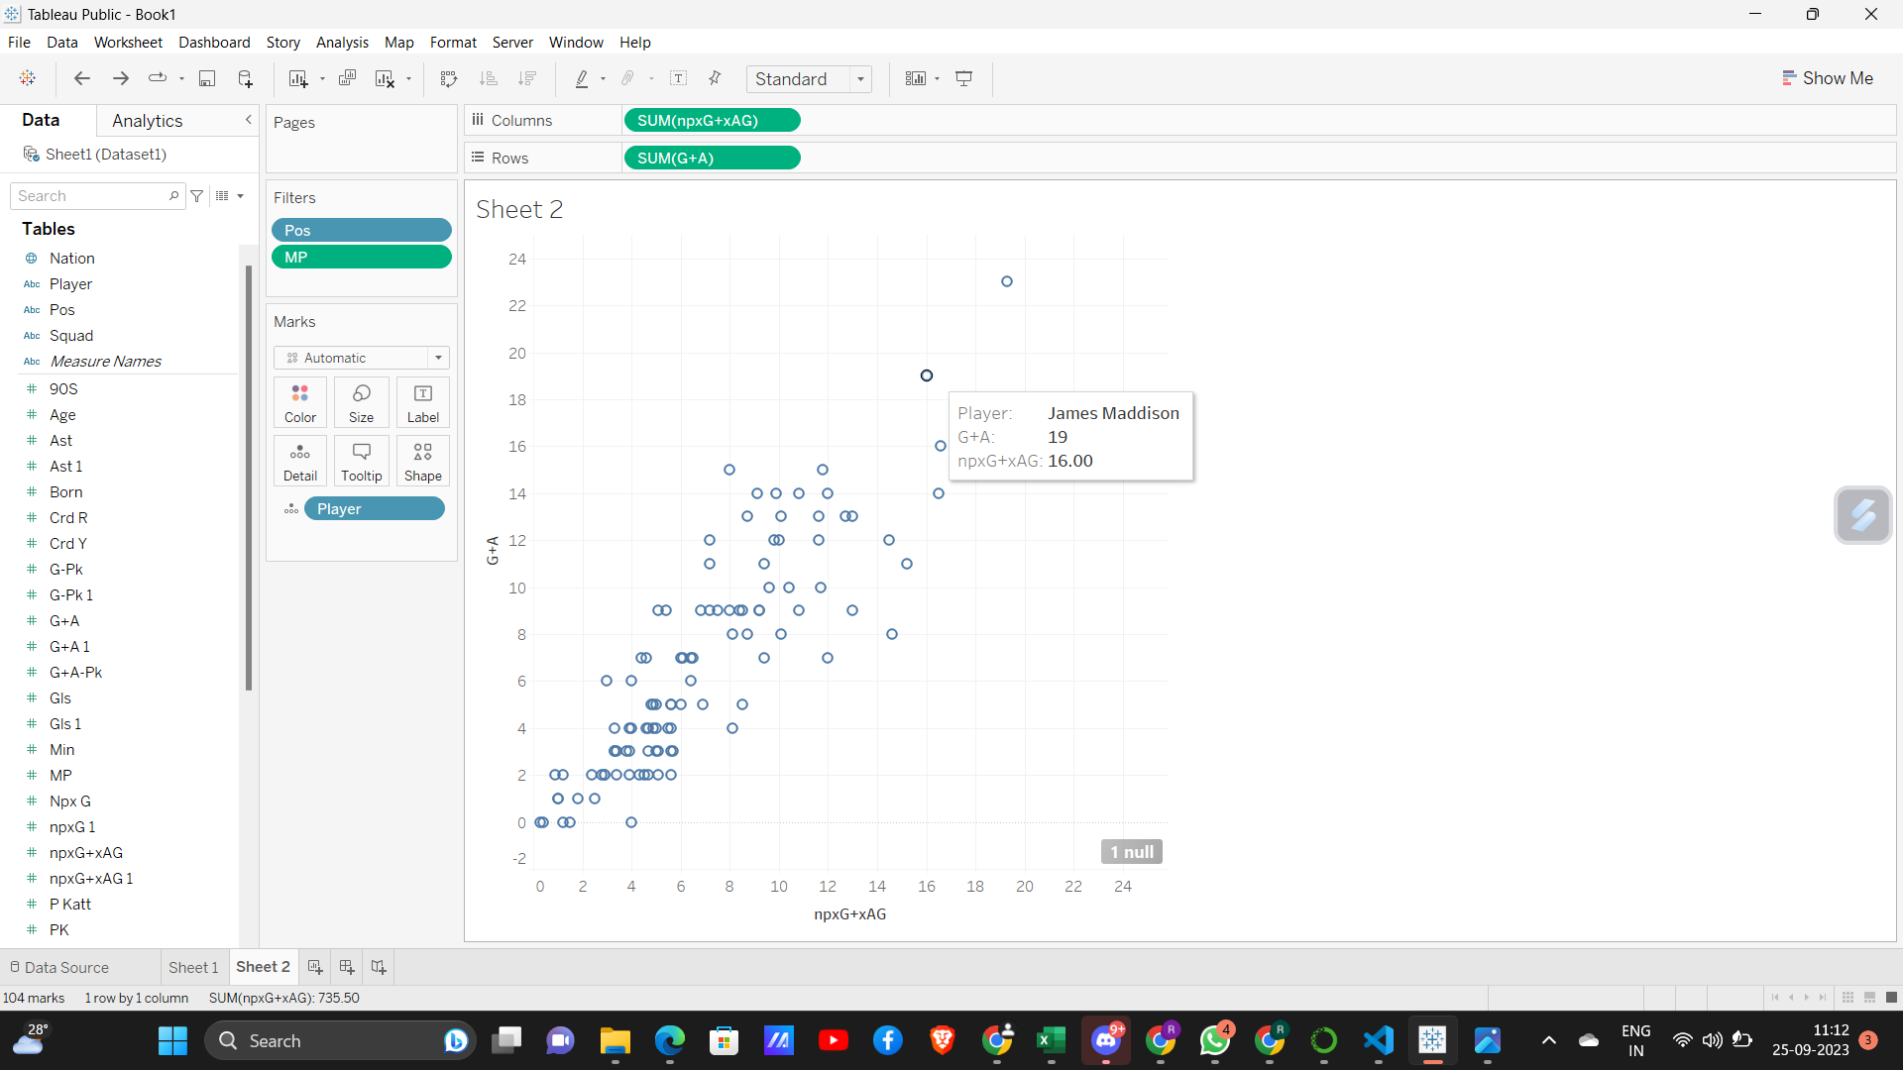

Slide 33
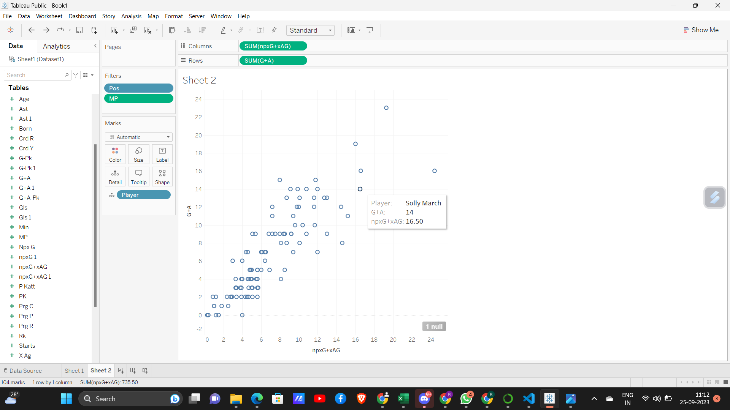

Slide 34
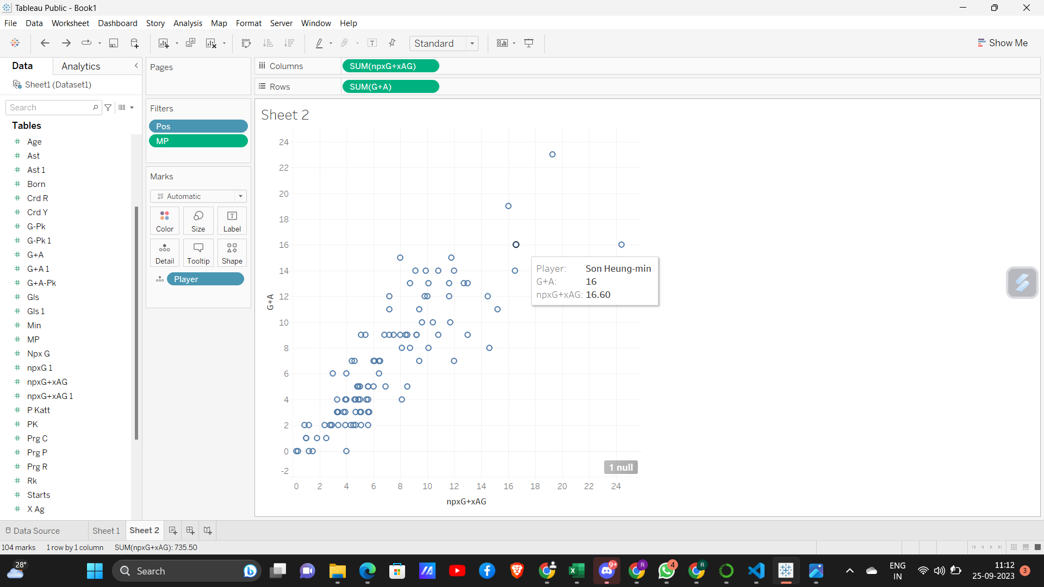

Slide 35
Now onto comparing the wingers
We would be comparing wingers on Expected Goals + Assists and Progressive Carries.

Slide 36
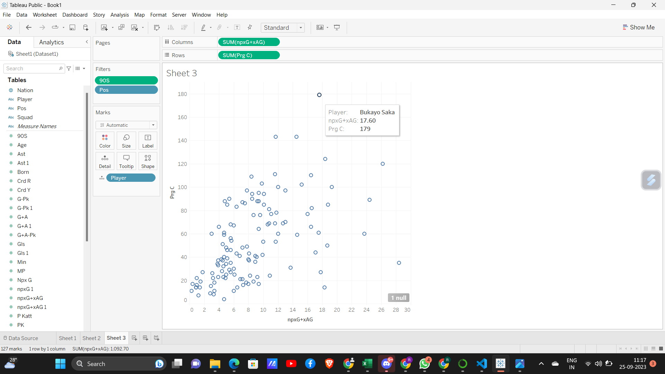

Slide 37
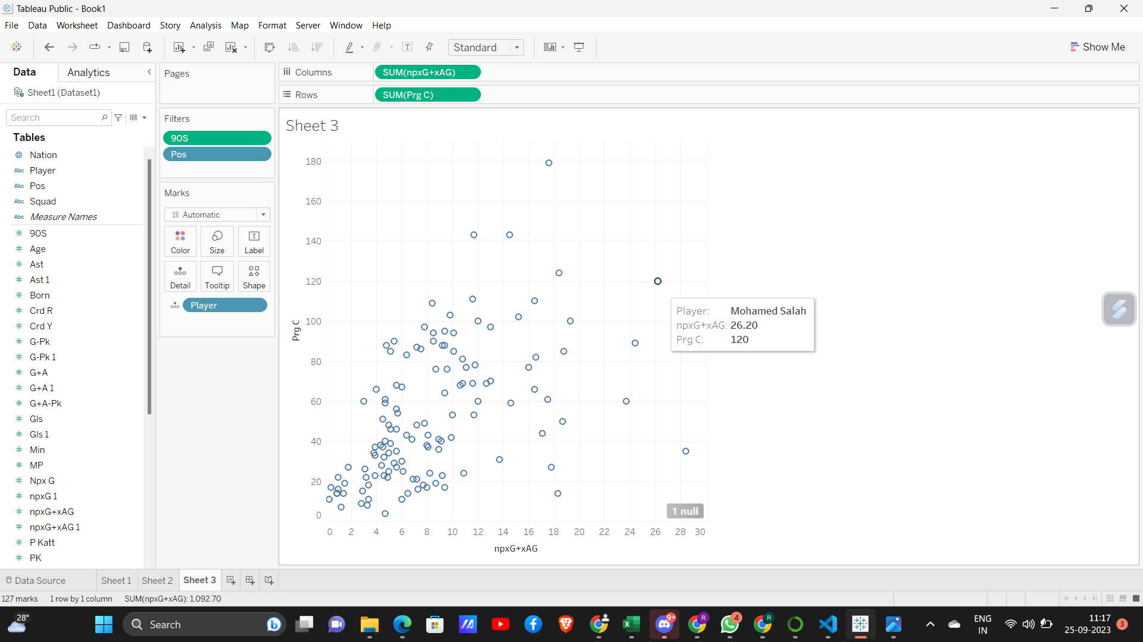

Slide 38


Slide 39
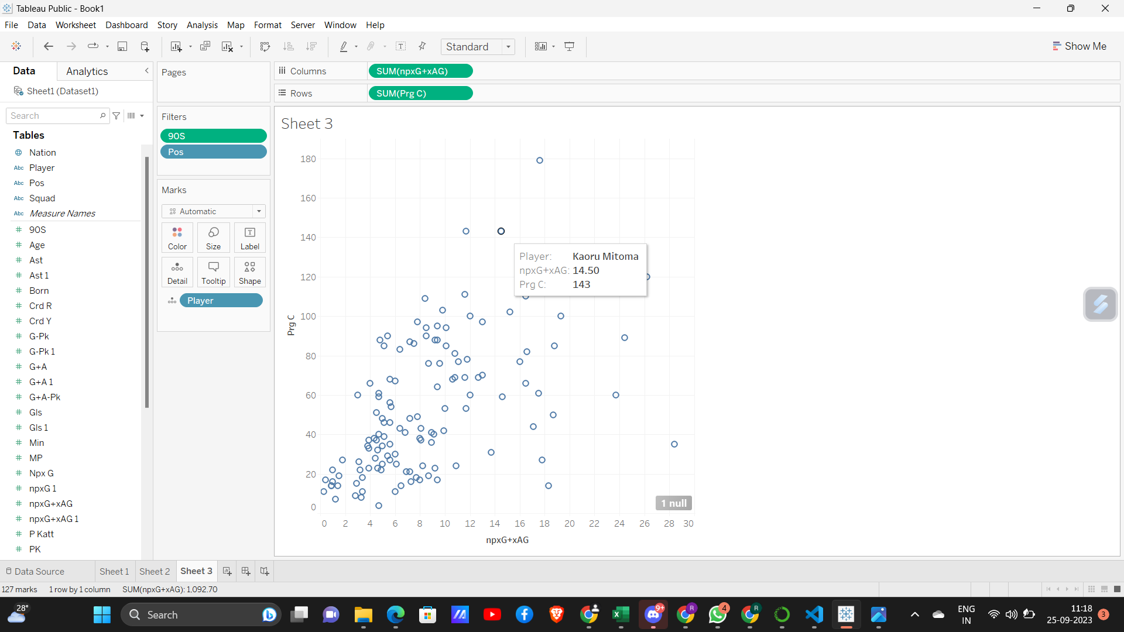

Slide 40
Creating advanced visualizations
Here we have created some advanced visualizations like shot map , shot heatmaps.
We firstly created pitch for the same

Slide 41
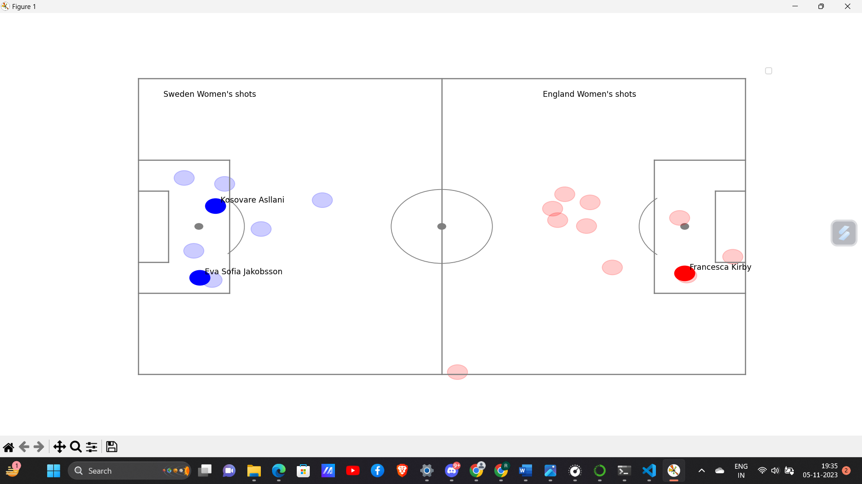

Slide 42
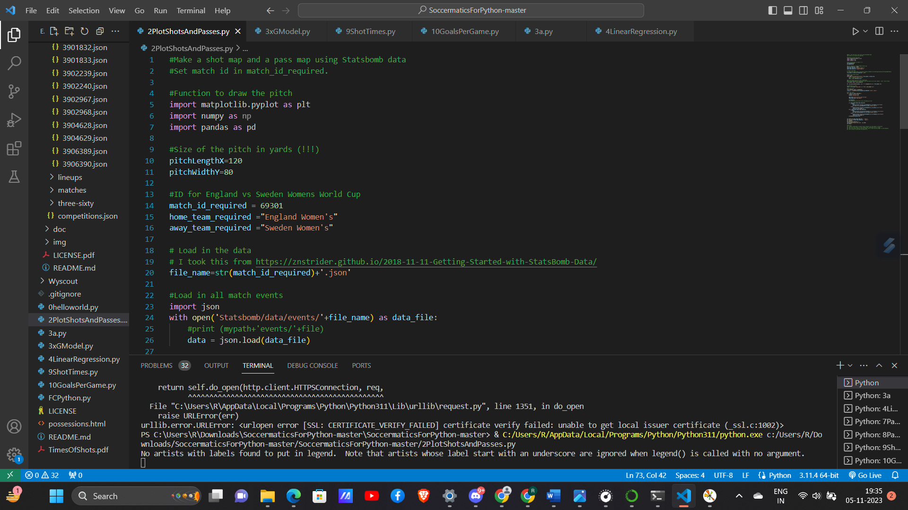
Code For the Previous Chart

Slide 43
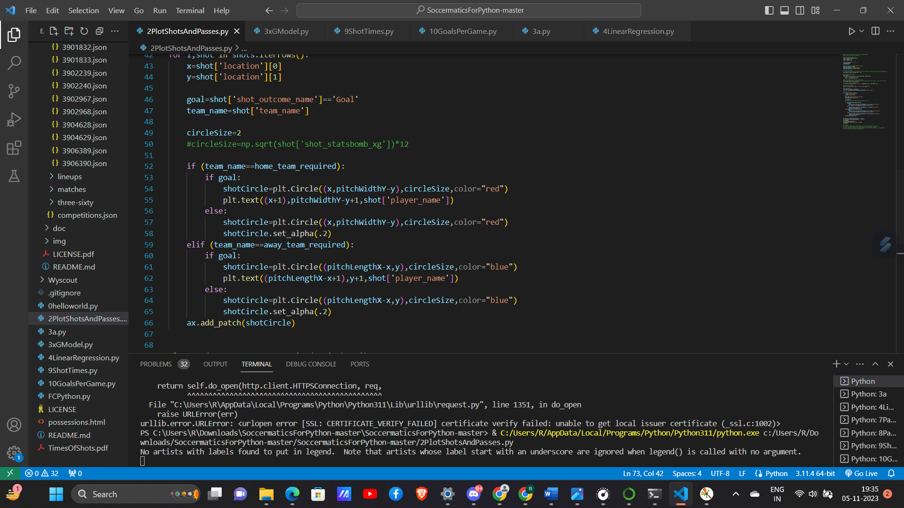

Slide 44
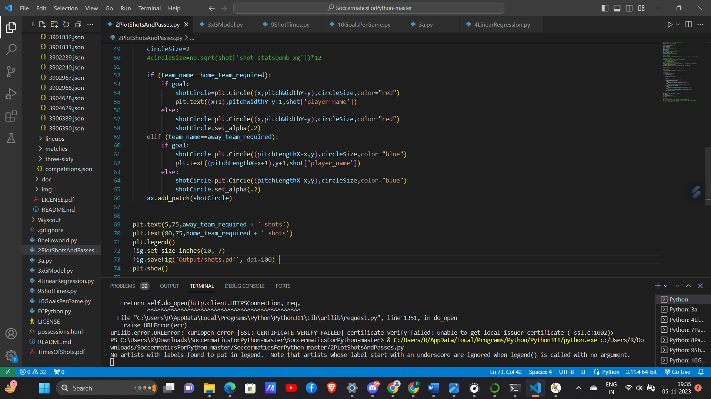

Slide 45
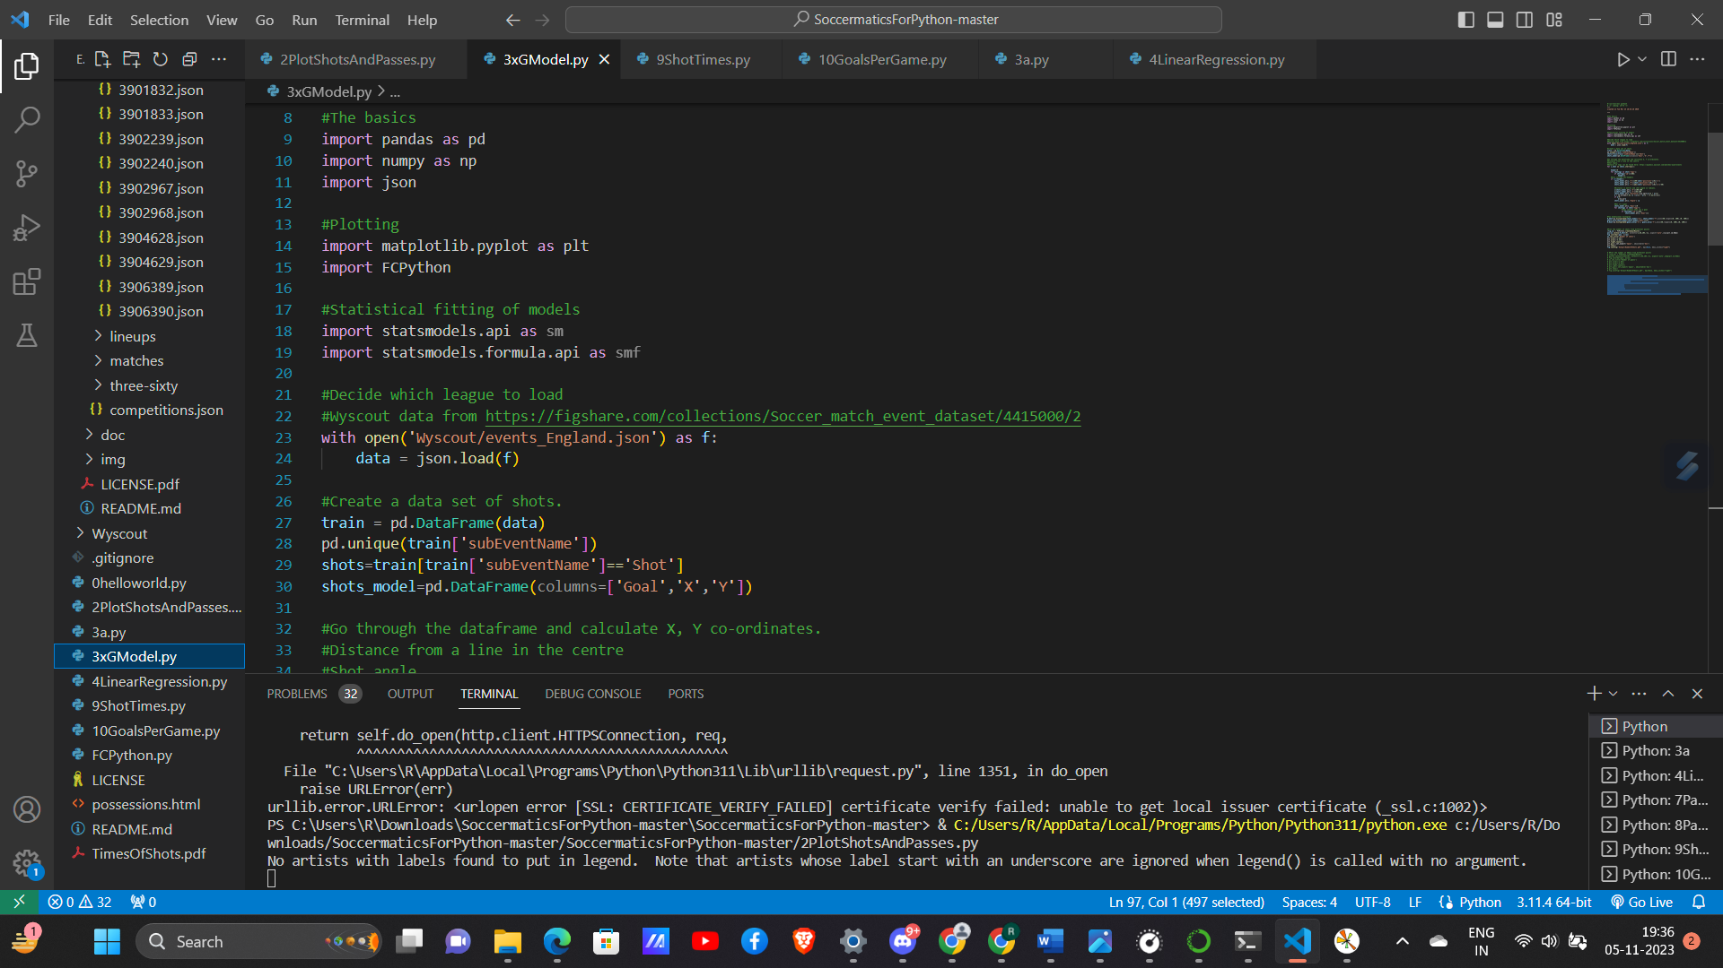
Creating a goal vs shot comparison

Slide 46
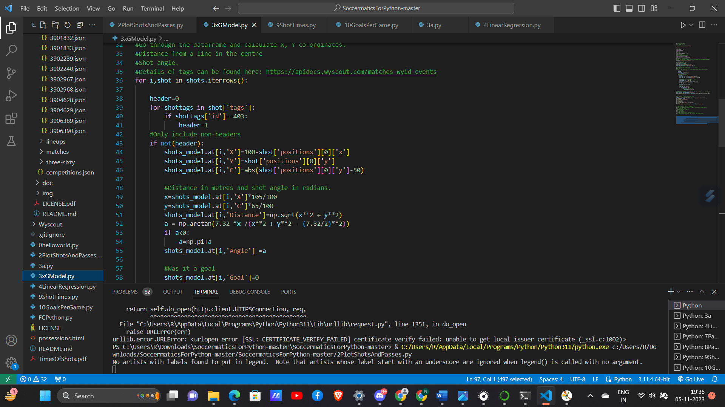

Slide 47
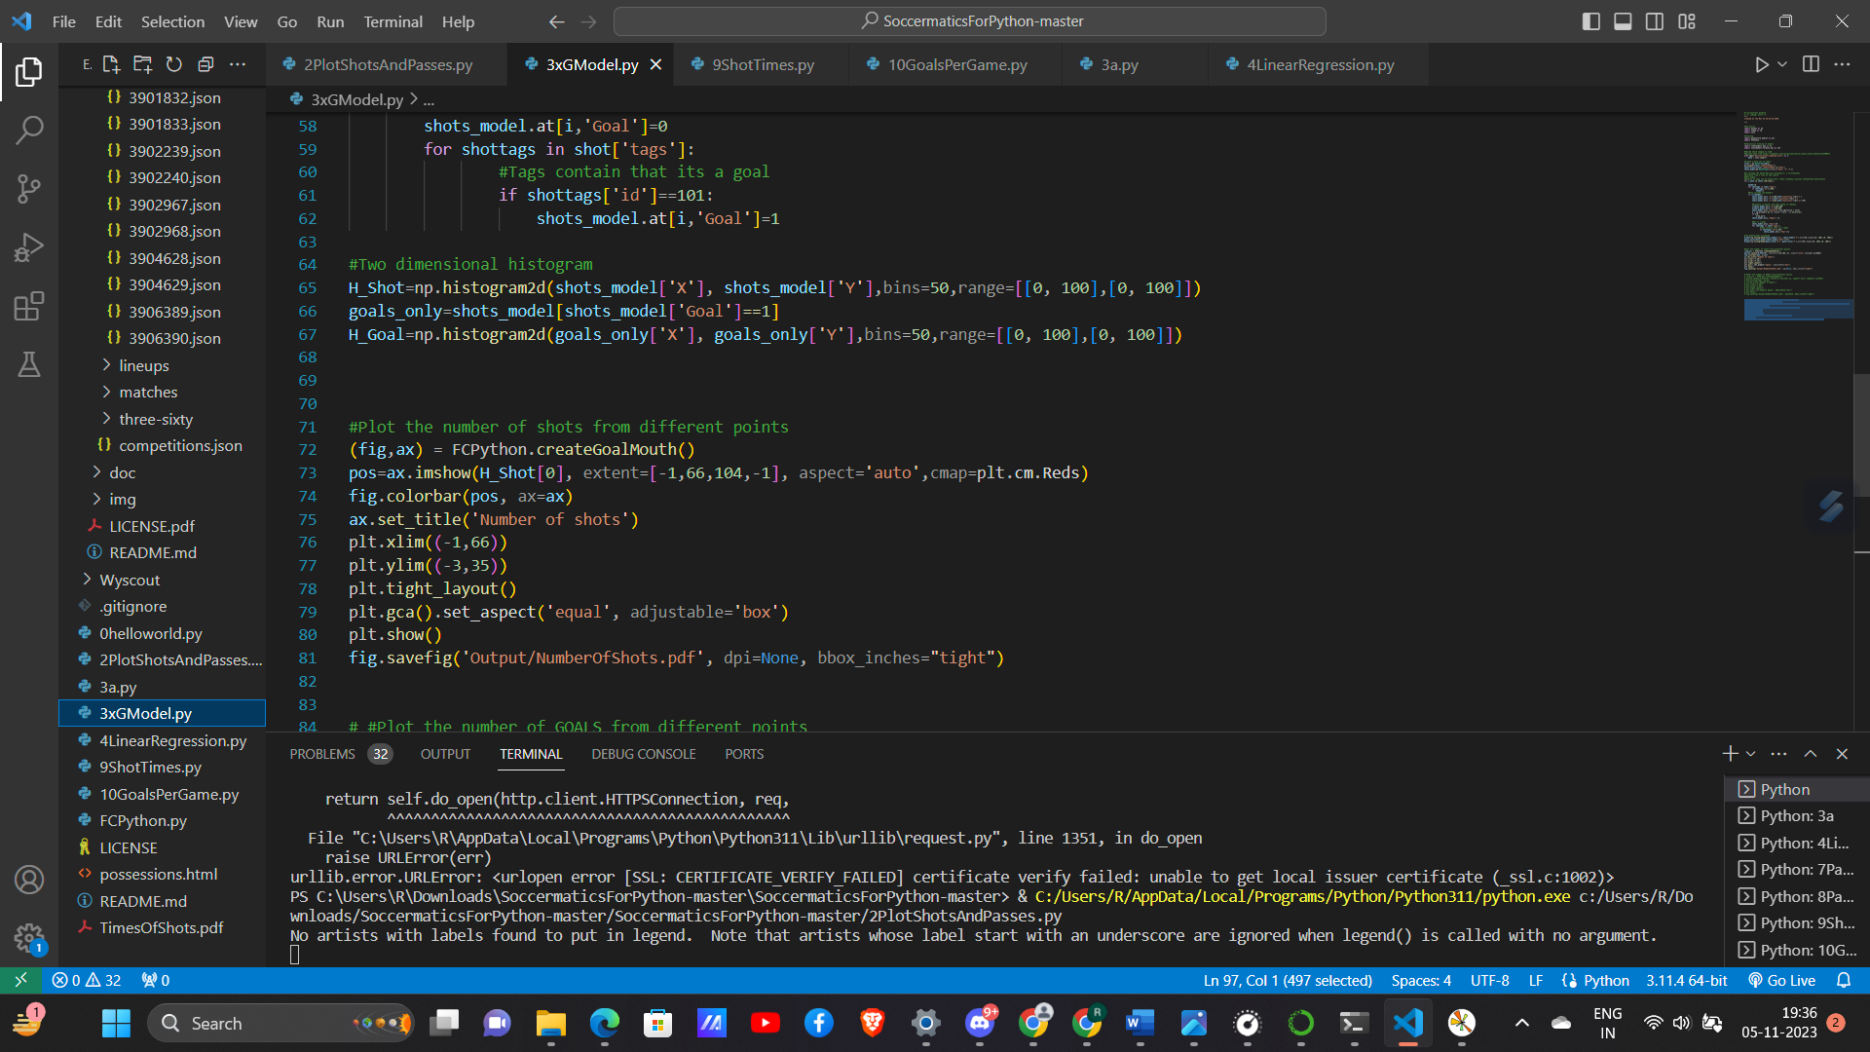

Slide 48
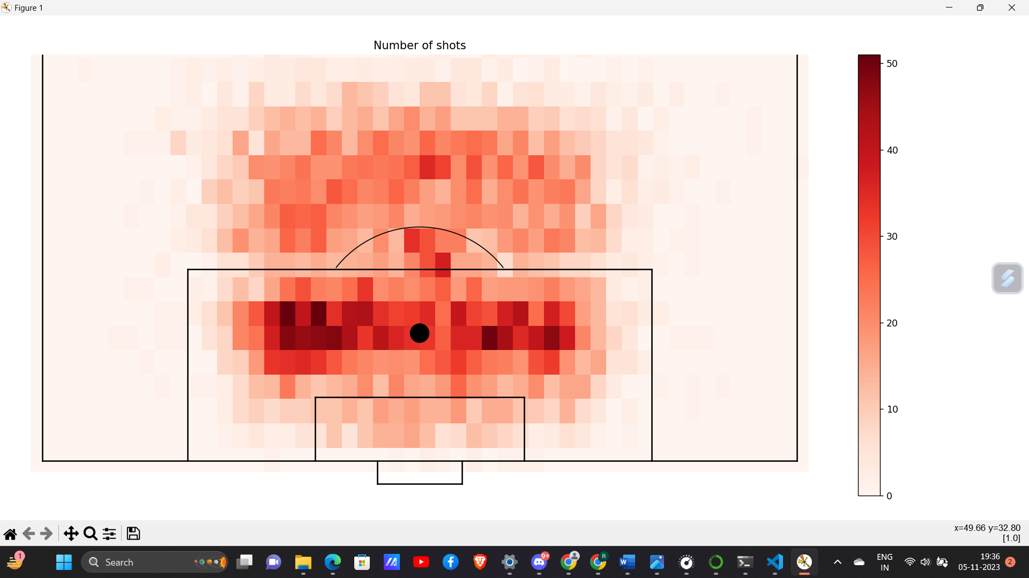

Slide 49
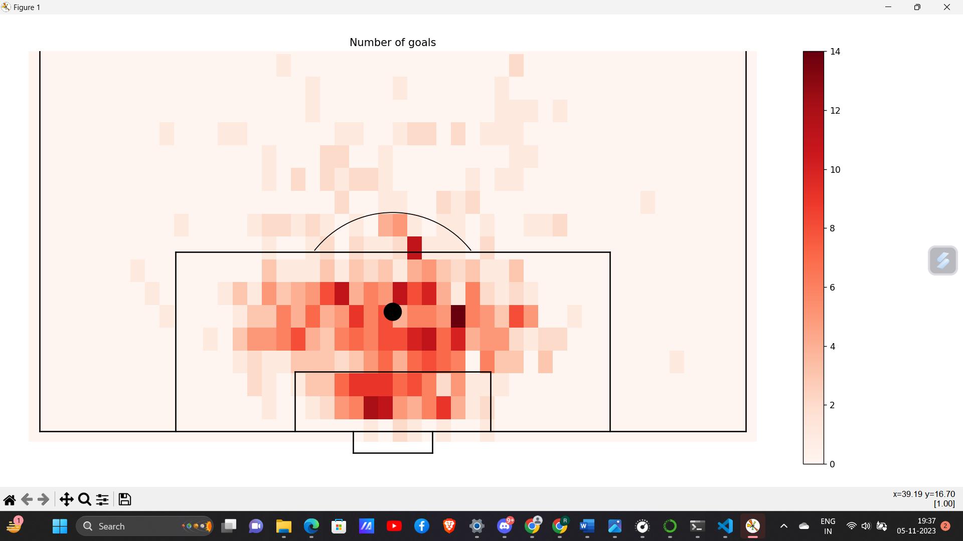

Slide 50
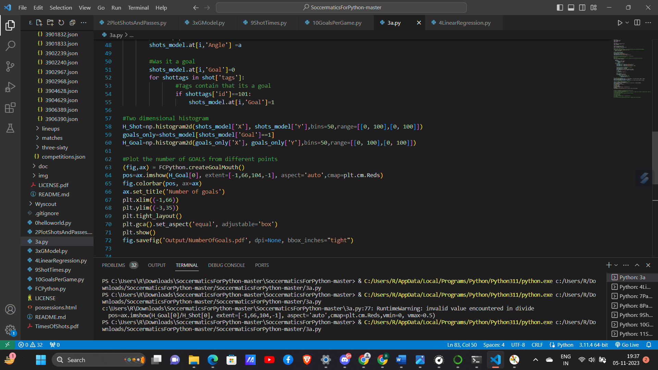

Slide 51
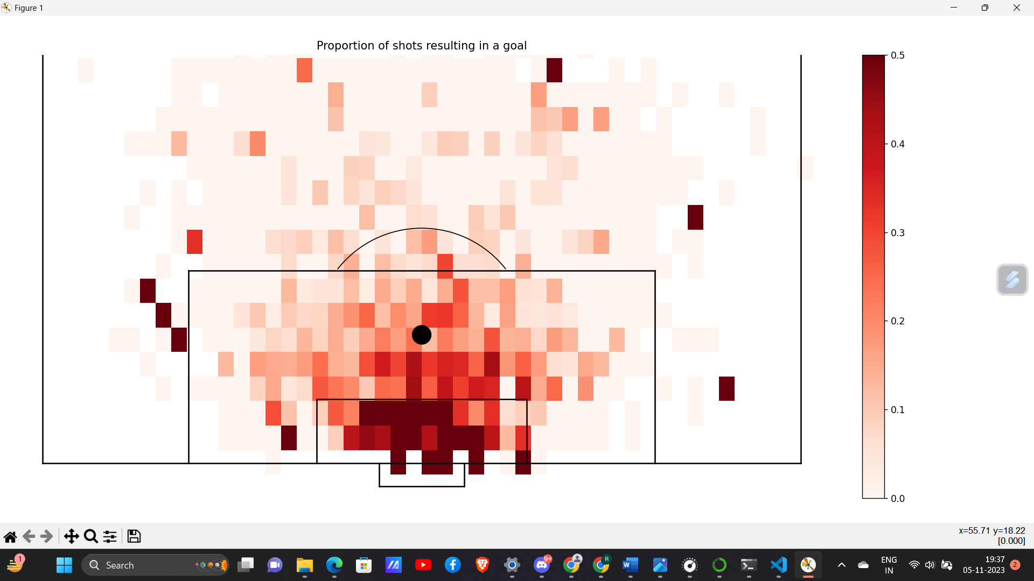

Slide 52
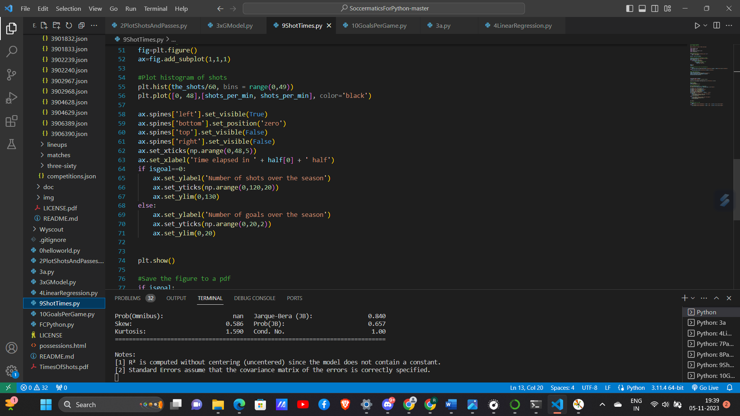

Slide 53
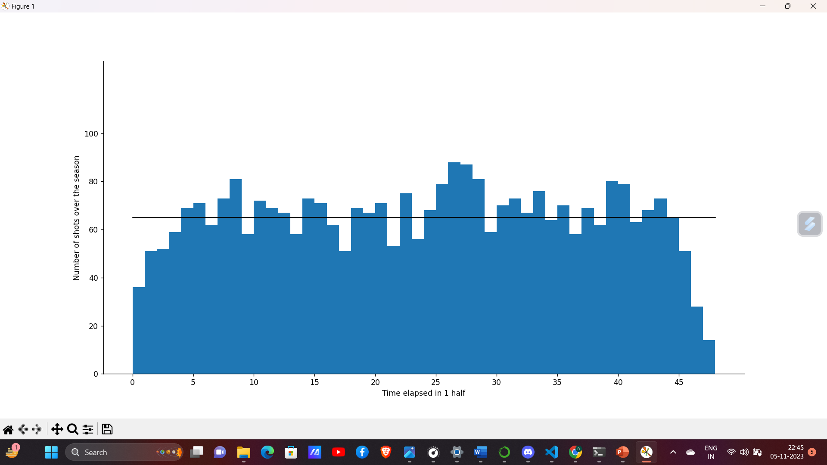
Histogram showing no. of shots /per minute in the first half

Slide 54
Comparing the messi vs Ronaldo rivalry
Football Icons: The Messi vs. Ronaldo rivalry defines an era of football greatness.
Individual Brilliance: Lionel Messi and Cristiano Ronaldo, two of the greatest players, compete for supremacy.
Clubs and Countries: Their rivalry extends from domestic leagues to international stages.
Records Galore: Constantly breaking records, they set new benchmarks in goal-scoring and individual achievements.
Global Debate: Fans worldwide engage in the perpetual debate over who truly reigns supreme.

Slide 55
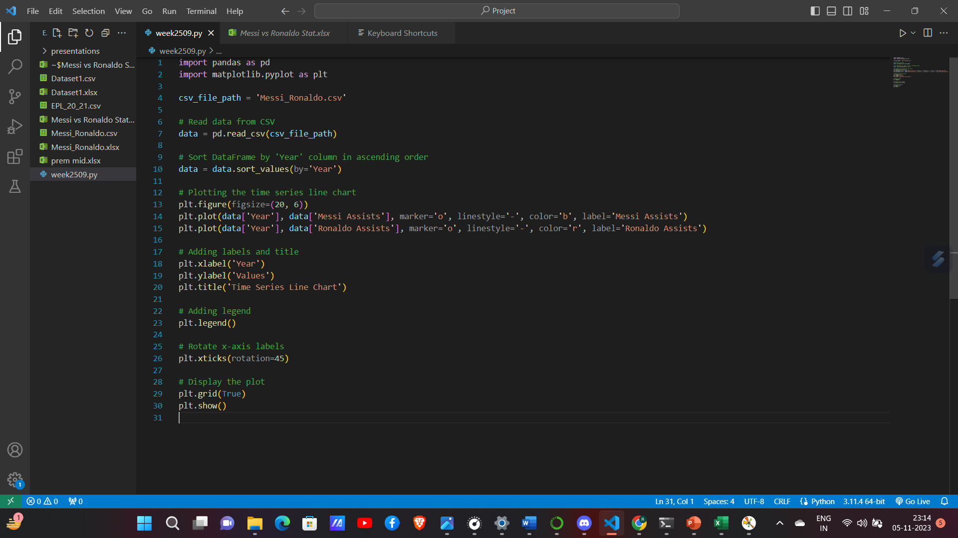
Comparing assists for club

Slide 56
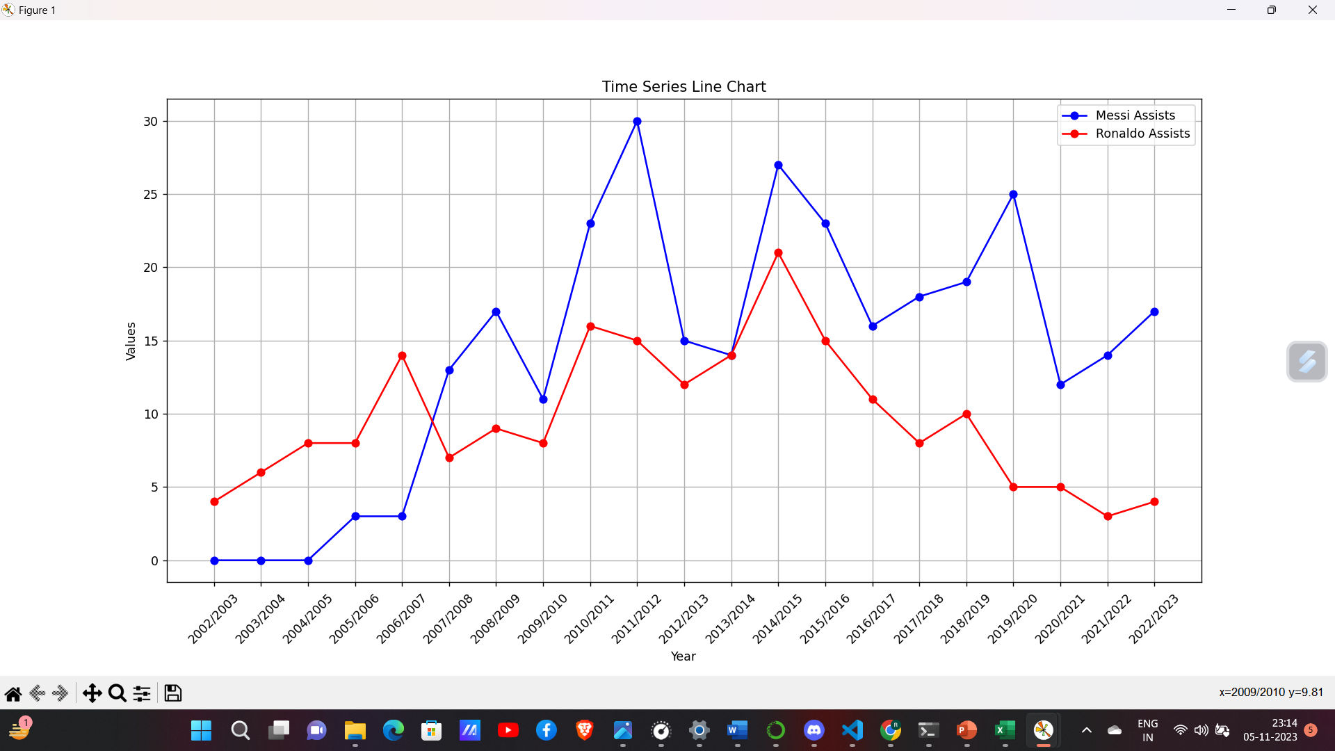

Slide 57
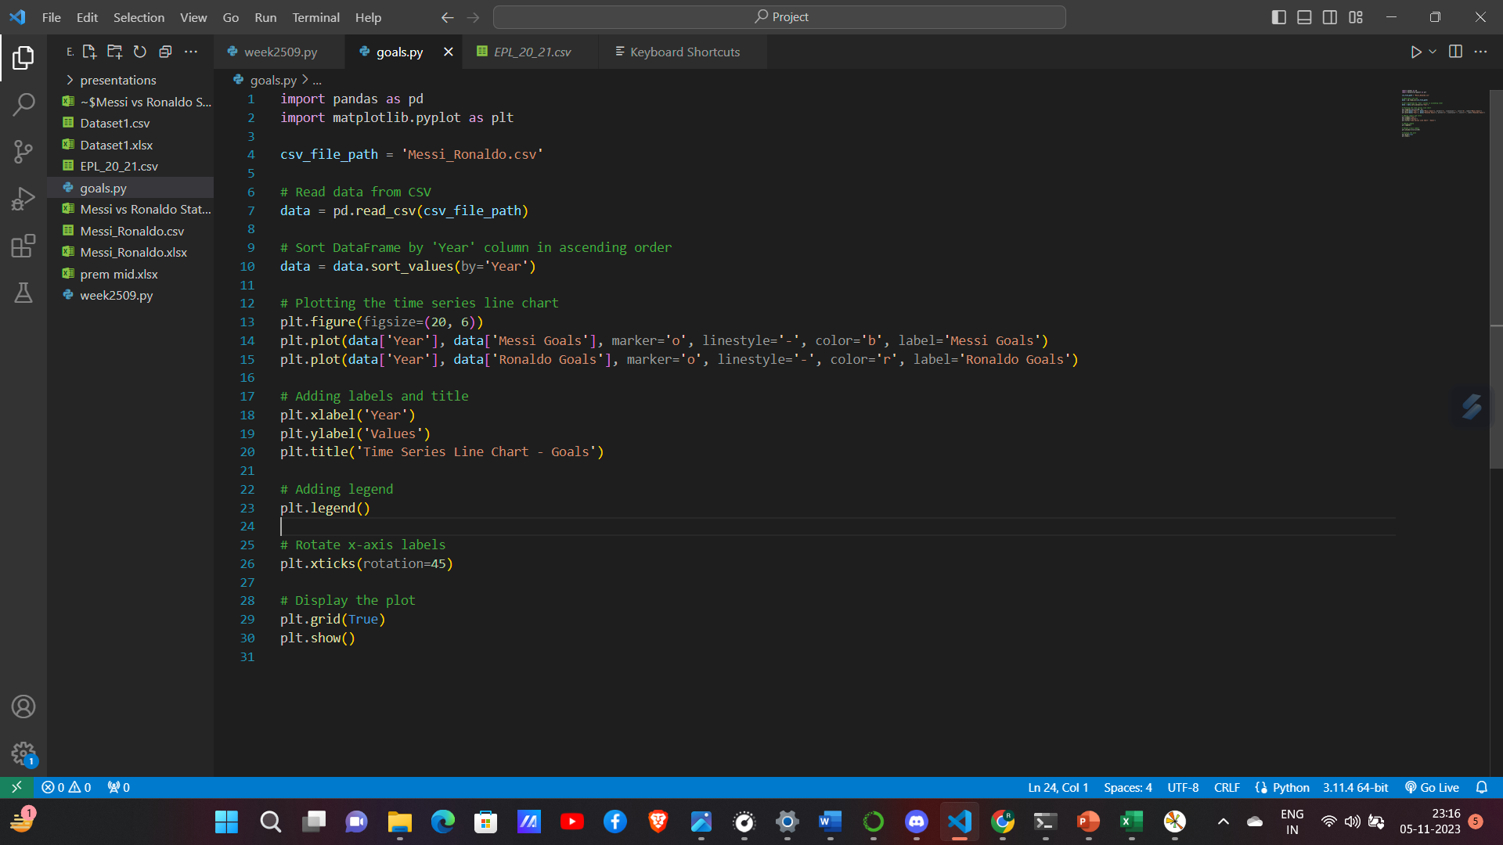
Comparing goals for club

Slide 58
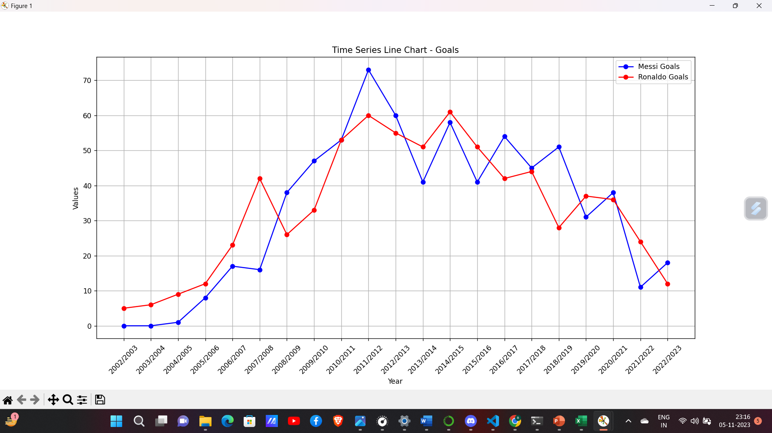

Slide 59
UCL Data Analytics
Premier Club Competition: The UEFA Champions League (UCL) stands as Europe's premier club football competition.
Elite Teams: It features the continent's top football clubs, showcasing the best talent.
Format: Teams from different European leagues compete in a tournament format.
Prestigious Trophy: The coveted trophy represents the pinnacle of European club success.
Global Audience: With a massive global viewership, it's a football spectacle of unparalleled magnitude.

Slide 60
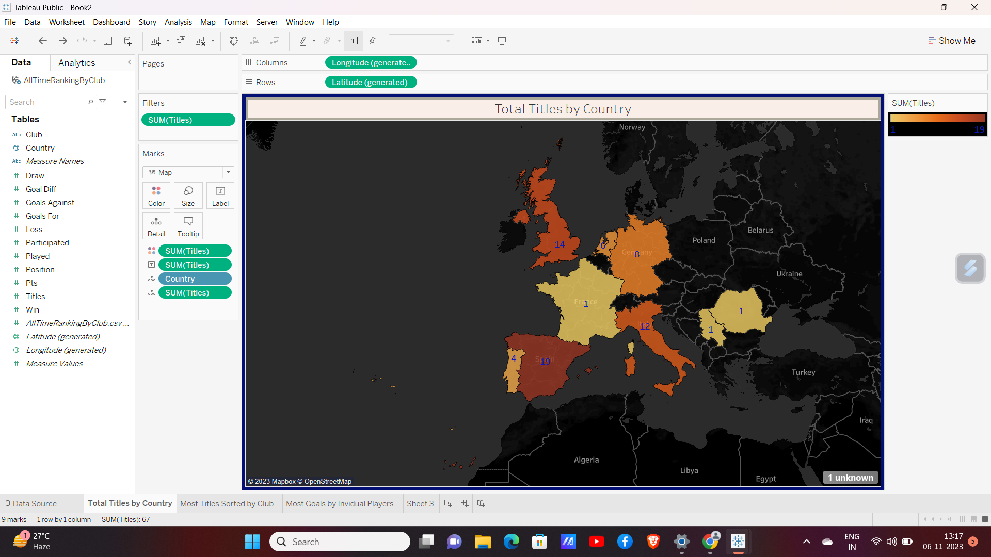
Ucl Geographical Map for titles

Slide 61
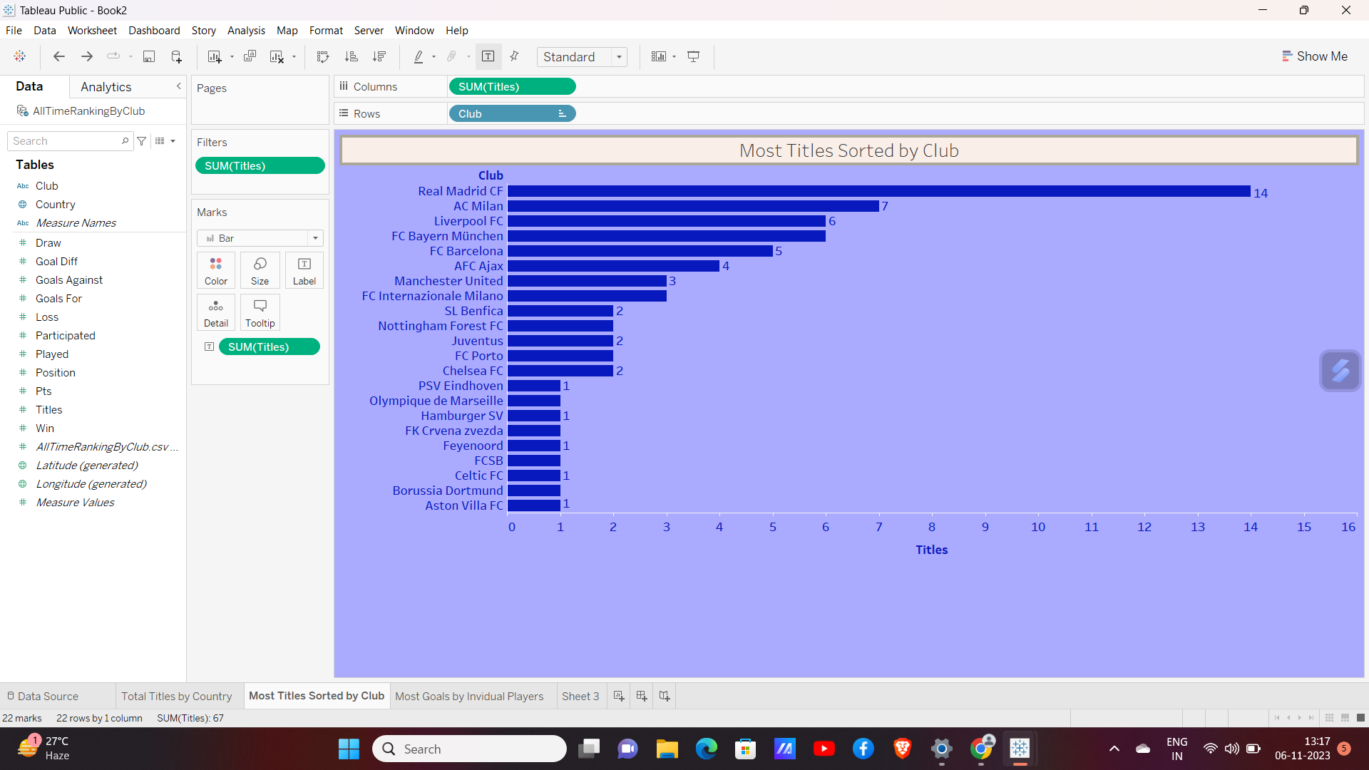
Club wise title using horizontal bar Chart

Slide 62
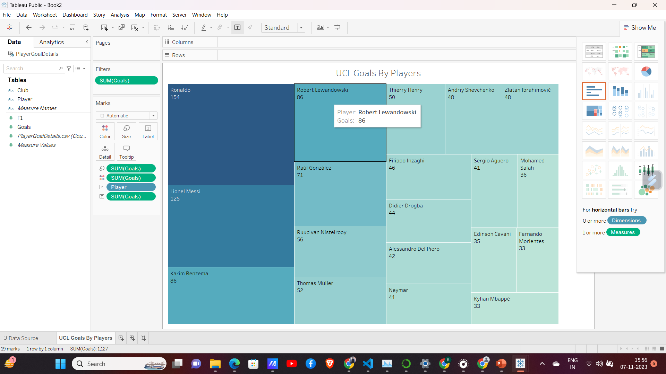
UCL GOALS BY PLAYERS

